Slide 1
Chapter 2
Socket communications and HTTP
Notes:
Network applications are behind the transformative power of the Internet. Without them the Internet would be just a fast way to send information, only slightly better than the fax machine.
What attributes of the Internet make it different?
- Responsiveness
-- The near real-time nature of Internet connectivity allows interactive applications
- Throughput
-- High enough to allow multimedia
- Generality
-- Allow the implementation of different types of distributed systems on simple services provided by networking protocols
Limitation of the Internet architecture?
- No guaranteed transmission rate
- No guarantees on end-to-end delay

Slide 2


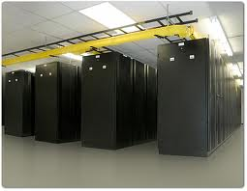


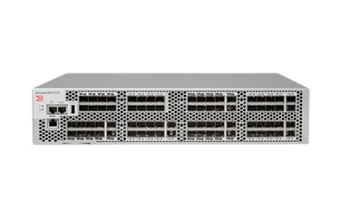


Process communications
Client
Server
Control by:
Application processes send msgs.
7: Application
Facebook
7: Application
7: Application
TCP
Application
4: Transport
4: Transport
4: Transport
IP
IP
Via sockets
3: Network
3: Network
3: Network
OS
2: Data link
GSM
2: Data link
GSM
Network cards and other h/w
2: Data link
EM
EM
1: Physical
1: Physical
1: Physical
Notes:
Is it enough to address messages to an IP address?

Slide 3
Internet transport protocols
User Datagram Prot. (UDP)
Transmission Control Prot. (TCP)
Unreliable data transfer
Connection-less
Don’t know if receiver is present
No flow control
Buffer overflow at receiver possible
No congestion control
Sender can overload the network
No guarantees on
End-to-end delay
Throughput
Security
Reliable stream transport
Connection-oriented
Establishes receiver presence
Flow control
Sender won’t overwhelm receiver
Congestion control
Senders won’t overload network
No guarantees on
End-to-end delay
Throughput
Security
Notes:
- Why bother? Why is there a UDP?
- Are there other transport protocols?
- Is TCP used for real-time communications?

Slide 4
Socket programming
TCP
UDP
UDP socket
#SERVER
s = socket.socket(socket.AF_INET,
socket.SOCK_STREAM)
s.bind ((‘127.0.0.1’, 80))
s.listen(1)
#CLIENT
s = socket.socket(socket.AF_INET,
socket.SOCK_STREAM)
s.connect((‘72.21.211.176’, 80))
s.send(bytes(‘GET ...’))
data = s.recv(BUFFER_SIZE)
s.close()
#SERVER conn, addr = s.accept()
data = conn.recv(BUFFER_SIZE)
conn.send(data) # echo
conn.close()
import socket
#SERVER
s = socket.socket(socket.AF_INET, socket.SOCK_DGRAM)
s.bind((‘127.0.0.1’, 5000))
#CLIENT
s = socket.socket(socket.AF_INET, socket.SOCK_DGRAM)
s.sendto(bytes(‘hello’), (‘153.90.118.46’,5000))
#SERVER
data, addr = s.recvfrom(BUFFER_SIZE)
Address family Internet
TCP socket
New socket
Remote address

Slide 5

UDP Communication Example

Slide 6
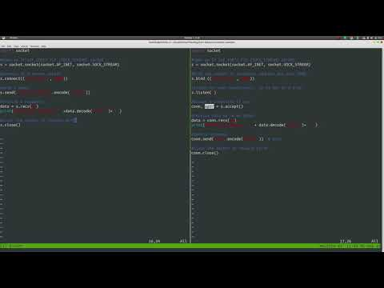
TCP Communication Example

Slide 7

Connection details
TCP
#SERVER
s = socket.socket(socket.AF_INET,
socket.SOCK_STREAM)
s.bind ((‘127.0.0.1’, 80))
s.listen(1)
#CLIENT
s = socket.socket(socket.AF_INET,
socket.SOCK_STREAM)
s.connect((‘72.21.211.176’, 80))
s.send(bytes(‘hello’))
data = s.recv(BUFFER_SIZE)
s.close()
#SERVER conn, addr = s.accept()
data = conn.recv(BUFFER_SIZE)
conn.send(data) # echo
conn.close()
153.90.118.46
72.21.211.176
Client
Server
Time
[(127.0.0.1,80), srv_sock]
[(153.90.118.46,5000), (72.21.211.176,80)]
[(127.0.0.1,1234), 153.90.118.46,5000)]
Socket uniquely identified by a four-tuple

Slide 8
HyperText Transfer Protocol (HTTP)
http://server.com/pathto/index.htm
HyperText Markup Language (HTML)
Language of the Web - now HTML5
Allows grouping of objects as content
Uniform Resource Locator (URL)
Addressing scheme for Web objects
HTTP supports HTML
Protocol for fetching objects from URLs
Uniform API for different platforms
Stateless protocol
Servers do not ‘remember’ past client requests
GET
Client
OK (+data)
Server
Request line
GET /index.html HTTP/1.1\r\n
Host: www.server.com\r\n
User-Agent: Firefox/3.6.10\r\n
Accept: text/html\r\n
Accept-Language: en-us,en; \r\n
Keep-Alive: 115\r\n
Connection: keep-alive\r\n
\r\n
scheme://domain:port/ path?query_string#fragment_id
Header lines
Double carriage return + line feed
Notes:
Why is stateless HTTP a good idea?

Slide 9
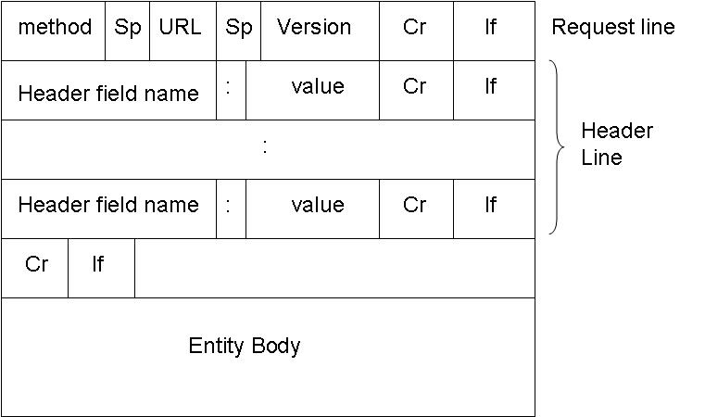
HTTP message format
GET: Download resource
HEAD: Get resource metadata
POST: Upload form contents
PUT: Upload object to URL
DELETE: Delete object from URL
HTTP/1.1 200 OK\r\n Connection: Close\r\n \r\n
Some HTTP responses:
200 OK: Data included
400 Bad Request: Bad formatting
404 Not Found: Object not on server
505 HTTP Version Not Supported: Data included
Notes:
Demo:
telnet www.cs.montana.edu 80
GET /~mwittie/ HTTP/1.1
Host: www.cs.montana.edu
HEAD /~mwittie/ HTTP/1.1
Host: www.cs.montana.edu

Slide 10

HTTP Example

Slide 11
HTTP API
HTTP relies on TCP
Not a transport protocol itself
Relies on E2E reliability and congestion control mechanisms of TCP
Application Programming Interfaces (APIs) in many High Level Languages (HLAs)
Ex. Python
import httplib
conn=httplib.HTTPConnection(“srvr.com")
conn.request("GET", "/pathto/object.jpg")
r = conn.getresponse()
data = r.read()
conn.close()
import urllib
params = urllib.urlencode( {'spam': 1, 'eggs': 2, 'bacon': 0})
f = urllib.urlopen("http://srvr.com/
cgi-bin/query?%s" % params)
data = f.read()
What is the format of data returned by the read() functions?
Notes:
HTTP message which contains HTML, or other data
- Gives flexibility in term so data content, but also structure to interpret responses

Slide 12
HTTP transfer modes
<!DOCTYPE html>
<html>
<body>
<h1>Some objects</h1>
<img src=“pic1.jpg" />
<img src=“pic2.jpg" />
</body>
</html>
GET index.htm
OK
GET pic1.jpg
Client
OK
Server
GET pic2.jpg
OK
Non-persistent connections (HTTP/1.0)
Each request over separate TCP connection
– Slow ramp up of TCP transfer rate
Parallel connections for multiple objects
– Wasted server resources
Persistent connections (HTTP/1.1)
One TCP connection for all objects
+ Low per client server overhead
Pipelining: objects requested in bulk
+ Allows TCP to reach fast transfer rates
Parallel transfers (HTTP/2.0)
Multiple elements loaded in parallel on same connection
Header compression
Eliminate head of line blocking
Server push
Notes:
Why is this slow?
Why is this wasteful of server resources?
How could we speed this up?

Slide 13
Client side data: Cookies
Save state
POST form_data
Problem
HTTP is stateless
Resending client data wastes network and server resources
Cookies
Associate client state on server with unique id
Clients refer to their state through id
Applications:
Authentication
Shopping carts
OK
set-cookie:1678
Client
Server
Save cookie
GET page.htm
cookie: 1678
DB
File
Read state
Cookies and privacy
Can store your personal information (forms, ad history, browsing history, shopping cart contents)
Can be exploited by other sites

Slide 14

Client side data: Caching
Problem
HTTP is stateless
Resending server data wastes bandwidth
Caching
Save previously delivered data
Subsequent requests served from cache on the browser, or in the access network
Applications
Reduce response time for client request
Reduce ISP traffic costs
Content distribution networks
Distributed caches
Web objects addressed to CDN server
CDN server fetches from content provider on first access
GET index.htm
GET
Client
OK
Cache
Server
Conditional GET
Cache: specify date of cached copy in HTTP request If-modified-since: <date>
Server: response contains no object if cached copy is up-to-date: HTTP/1.0 304 Not Modified
Why is sending a conditional GET all the way to the server still faster, than a non-conditional GET?

